Slide 1

Strategies for Enhancing Dostt
Analysis and Recommendations
By
Jayant jain

Slide 2
Increasing Average Talk Time
Based on play store review
Personalized Conversation Prompts
Gamification & Incentives
Introduce daily/weekly challenges, streaks, and reward tiers for hitting talk-time milestones.
Track average talk time, challenge participation rate, and reward redemption rate.
Use AI to suggest relevant topics based on user preferences and previous interactions.
Monitor conversation length, engagement rate, and feedback on topic relevance.
Enhanced User Experience
Improve the app interface with voice/video features and easy transitions between conversations.
Track session duration, feature usage, and app retention rate.

Slide 3
Solving Night-Time Mismatch
Incentivize Night-Time Engagement:
Offer higher incentives for Superdostts during off-peak hours (night shifts).
Run limited-time promotions or "Night Owl" bonuses for increased talk time during 8 PM to 2 AM.
Targeted Push Notifications:
Remind Superdostts about increased demand and incentives during night hours.
Encourage Dostts to join and engage during these hours by highlighting available Superdostts.
User Behavior Analysis:
Identify time-sensitive preferences of users during the night and personalize calls accordingly (e.g., calming conversations, specific topics for night shifts).

Slide 4
TRACKING MISMATCH
Superdostts Availability
Supply vs. Demand Measure the gap between available Superdostts and waiting Dostts.
Engagement Metrics
Incentive Impact
Track the number of Superdostts active during 8 PM to 2 AM and their average talk time.
Monitor user retention, satisfaction ratings, and call duration specifically during these hours.
Track how night-time incentives affect the number of Superdostts available and call success rate.

Slide 5
Converting DOSTS to Superdostts
Pitch
Earn Flexibly
Be a Friend
Flexible and Fun
Approach
Highlight success stories.
Simplify onboarding.
Offer referral bonuses.
Turn your conversations into earnings
Make an impact through friendly interactions.
Work on your schedule, be your own boss.

Slide 6
Tracking Performance
User-Superdostt Match Metrics:
Call Match Rate and Time-to-Match.
Match Quality feedback scores.(ratings)
Superdostt Performance Metrics:
Talk Time (daily/weekly).
Retention Rate and conversation quality.
Availability hours vs. demand.

Slide 7
monetization
Base Payment
Hourly Rate: A fixed base hourly rate for active Superdostts. For example, ₹X per hour of active engagement on calls
Performance-Based Incentives
Call Duration Bonus Superdostts who consistently meet or exceed a target of 3-4 hours per day/week earn a bonus.
Peak Hour Premium Superdostts who work during high-demand times (e.g., 8 PM - 2 AM) can receive a premium rate.
Referral Bonus: If a Superdostt refers other active users who join and remain on the platform, they receive a referral bonus.
Penalty Structure (if applicable)
Low Engagement or Inactivity Penalty: Superdostts who don’t meet minimum activity thresholds (e.g., less than 5 hours/week) can face a slight penalty or reduced base rate in the next payout cycle.
Example: Deduct ₹E for every week below the activity threshold.

Slide 8
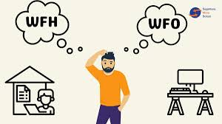
Wfh or wfh
Work from Home:
Gives the employees flexibility and saves their commuting time
If the work type is mostly digital then there is no dependency for field work
It saves the company operational costs
Work from Office:
Good for employees to connect and network with more people
Contribute in making work more efficient as office gives a better working environment
Better team communication and faster conflict resolution
I believe that both the situations are effective in their own way.In my opinion hybrid or work from office are more effective in terms of efficiency, team building and employees growth.

Slide 9
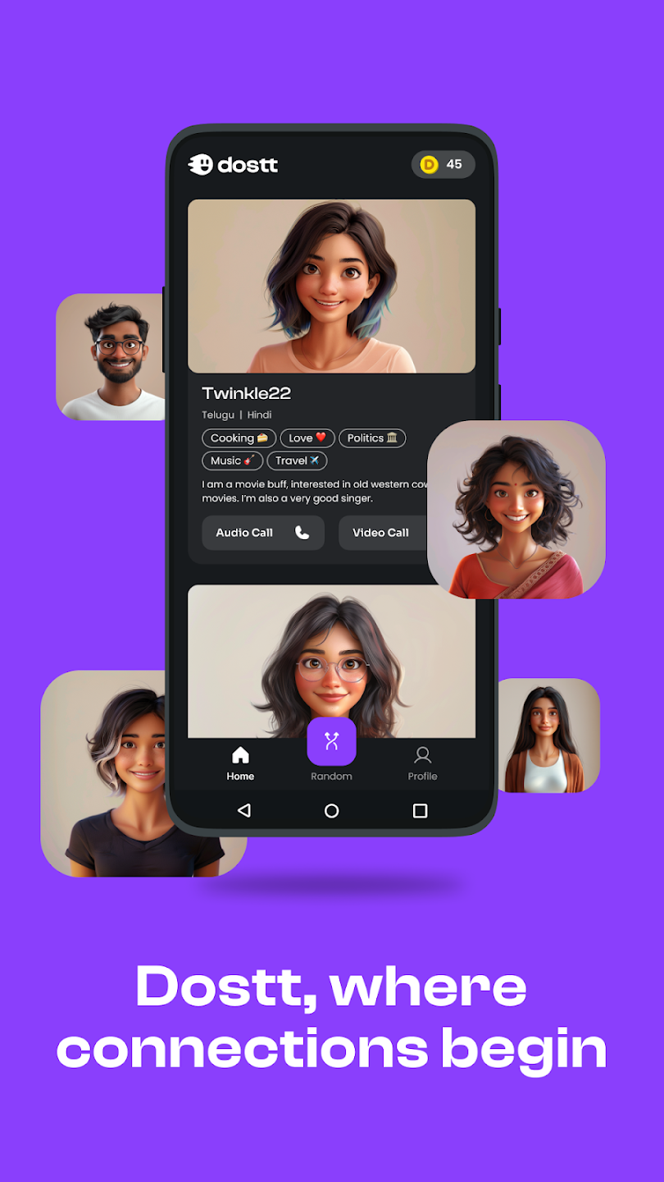
Thank you

